Slide 1
Subqueries

Slide 2
Objectives
Determine when it is appropriate to use a subquery
Identify which clauses can contain subqueries
Distinguish between an outer query and a subquery
Use a single-row subquery in a WHERE clause
Use a single-row subquery in a HAVING clause
Use a single-row subquery in a SELECT clause
Oracle 10g: SQL

Slide 3
Objectives (continued)
Distinguish between single-row and multiple-row comparison operators
Use a multiple-row subquery in a WHERE clause
Use a multiple-row subquery in a HAVING clause
Use a multiple-column subquery in a WHERE clause
Oracle 10g: SQL

Slide 4
Objectives (continued)
Create an inline view using a multiple-column subquery in a FROM clause
Select * from ( SELECT deptno, count(*) emp_count FROM emp GROUP BY deptno ) emp, dept WHERE dept.deptno = emp.deptno;
Distinguish between correlated and uncorrelated subqueries
Nest a subquery inside another subquery
Oracle 10g: SQL

Slide 5
Subqueries and Their Uses
Subquery - a query nested inside another query
Used when a query is based on an unknown value
Requires SELECT and FROM clauses
Must be enclosed in parentheses
Place on right side of comparison operator
Oracle 10g: SQL

Slide 6
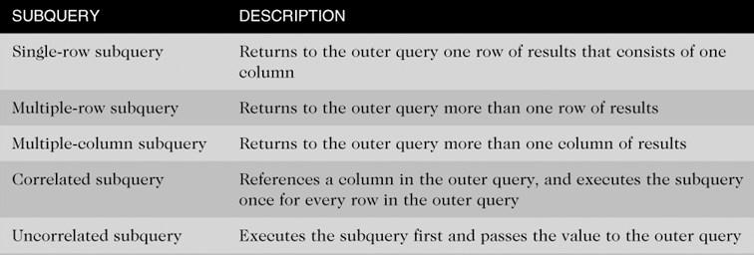
Types of Subqueries
Oracle 10g: SQL

Slide 7
Single-Row Subqueries
Can only return one result to the outer query
Operators include =, >, <, >=, <=, < >
Oracle 10g: SQL

Slide 8
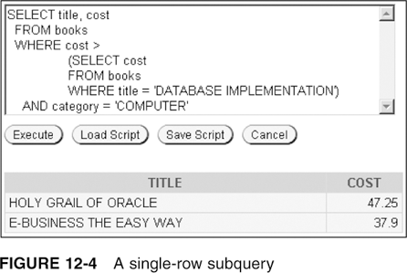
Single-Row Subquery in a WHERE Clause
Used for comparison against individual data
Oracle 10g: SQL

Slide 9
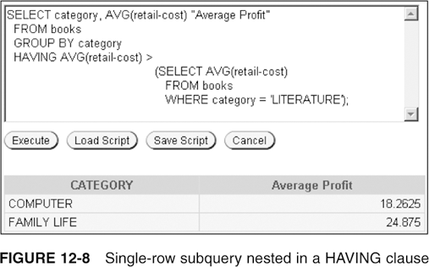
Single-Row Subquery in a HAVING Clause
Required when returned value is compared to grouped data
Oracle 10g: SQL

Slide 10
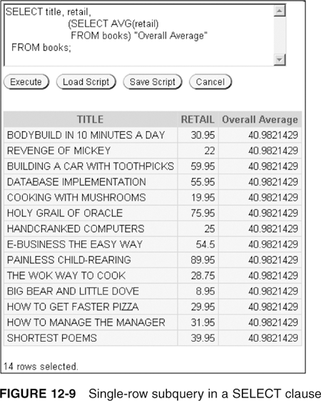
Single-Row Subquery in a SELECT Clause
Replicates subquery value for each row displayed
Oracle 10g: SQL

Slide 11
Multiple-Row Subqueries
Return more than one row of results
Require use of IN, ANY, ALL, or EXISTS operators
Oracle 10g: SQL

Slide 12
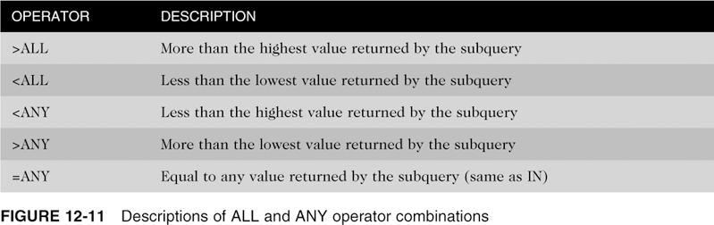
ANY and ALL Operators
Combine with arithmetic operators
Oracle 10g: SQL

Slide 13
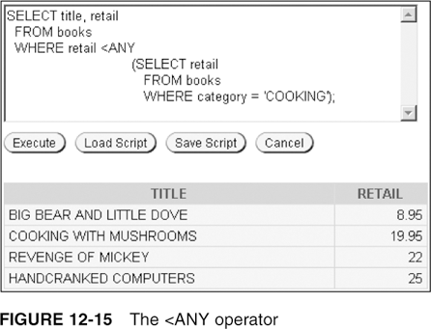
Multiple-Row Subquery in a WHERE Clause
Oracle 10g: SQL

Slide 14
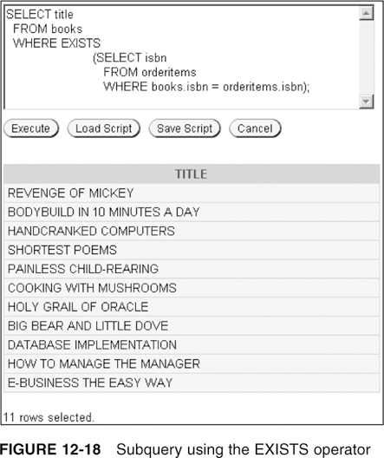
EXISTS Operator
Determines whether condition exists in subquery
Oracle 10g: SQL

Slide 15
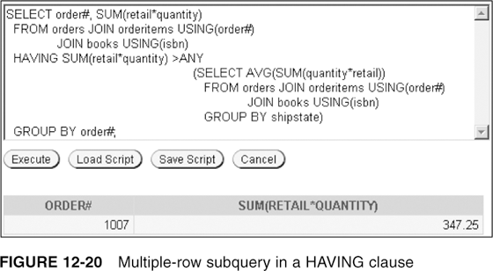
Multiple-Row Subquery in a HAVING Clause
Oracle 10g: SQL

Slide 16
Multiple-Column Subqueries
Return more than one column in results
Can return more than one row
Column list on the left side of operator must be in parentheses
Use the IN operator for WHERE and HAVING clauses
Oracle 10g: SQL

Slide 17
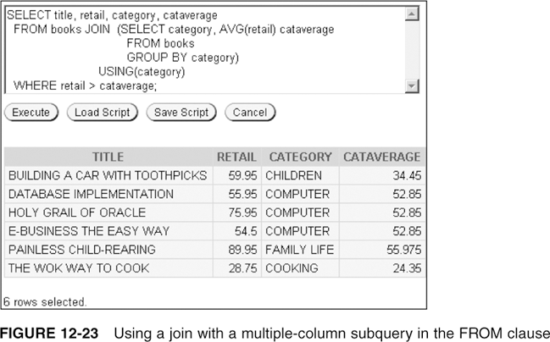
Multiple-Column Subquery in a FROM Clause
Creates a temporary table
Oracle 10g: SQL

Slide 18
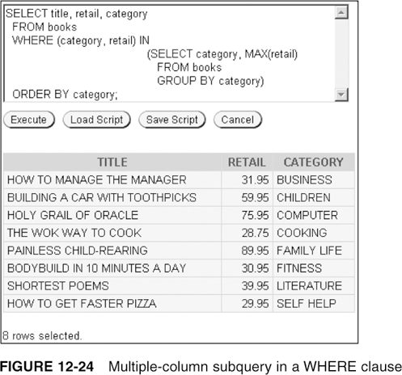
Multiple-Column Subquery in a WHERE Clause
Returns multiple columns for evaluation
Oracle 10g: SQL

Slide 19
Uncorrelated Subqueries
Processing sequence:
  Inner query is executed first
  Result is passed to outer query
  Outer query is executed
Oracle 10g: SQL

Slide 20
Correlated Subqueries
Inner query is executed once for each row processed by the outer query
Inner query references the row contained in the outer query
Oracle 10g: SQL

Slide 21
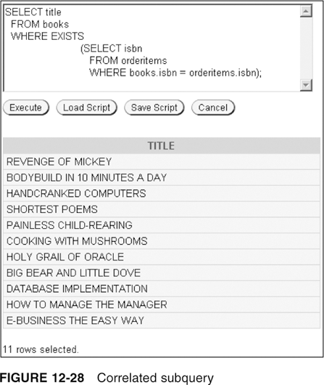
Correlated Subqueries (continued)
Oracle 10g: SQL

Slide 22
Nested Subqueries
Maximum of 255 subqueries if nested in the WHERE clause
No limit if nested in the FROM clause
Innermost subquery is resolved first, then the next level, etc.
Oracle 10g: SQL

Slide 23
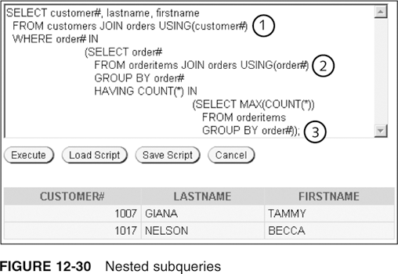
Nested Subqueries
Innermost is resolved first (3), then the second level (2), then the outer query (1)
Oracle 10g: SQL

Slide 24
Summary
A subquery is a complete query nested in the SELECT, FROM, HAVING, or WHERE clause of another query
  The subquery must be enclosed in parentheses and have a SELECT and a FROM clause, at a minimum
Subqueries are completed first; the result of the subquery is used as input for the outer query
A single-row subquery can return a maximum of one value
Single-row operators include =, >, <, >=, <=, and <>
Multiple-row subqueries return more than one row of results
Oracle 10g: SQL

Slide 25
Summary (continued)
Operators that can be used with multiple-row subqueries include IN, ALL, ANY, and EXISTS
Multiple-column subqueries return more than one column to the outer query
NULL values returned by a multiple-row or multiple-column subquery will not present a problem if the IN or =ANY operator is used
Correlated subqueries reference a column contained in the outer query
Subqueries can be nested to a maximum depth of 255 subqueries in the WHERE clause of the parent query
Oracle 10g: SQL

Slide 26
Summary (continued)
With nested subqueries, the innermost subquery is executed first, then the next highest level subquery is executed, and so on, until the outermost query is reached
Oracle 10g: SQL

